Slide 1
Introduction to Quantum Algorithms
CS.49900 (Spring 2026)
Grover’s algorithm and applications

Slide 2
Today: Grover’s algorithm
Previous algorithms (Simon, Duetsch-Josza)
require a strong promise of the problem
have exponential quantum speed up
are based on Quantum Fourier transform (specifically, QFT-do something-QFT)
(Shor’s algorithm has the same style, but we will learn it later.)
Grover algorithm:
has a (quadratic) quantum speedup
applies to general problems (without strong promise!)
has a bit different structure!

Slide 3
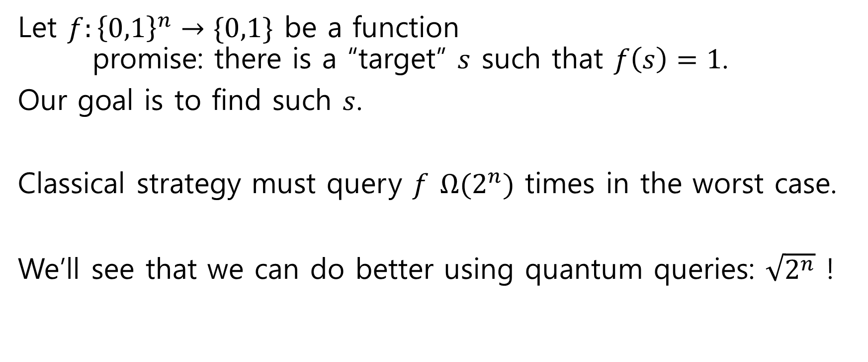
Preimage Finding Problem
Let $f:{\left\{0,1\right\}}^{n}→\{0,1\}$ be a function promise: there is a “target” $s$ such that $f\left(s\right)=1$.
Our goal is to find such $s$.
Classical strategy must query $f$ $Ω(2^{n})$ times in the worst case.
We’ll see that we can do better using quantum queries: $\sqrt{2^{n}}$ !

Slide 4
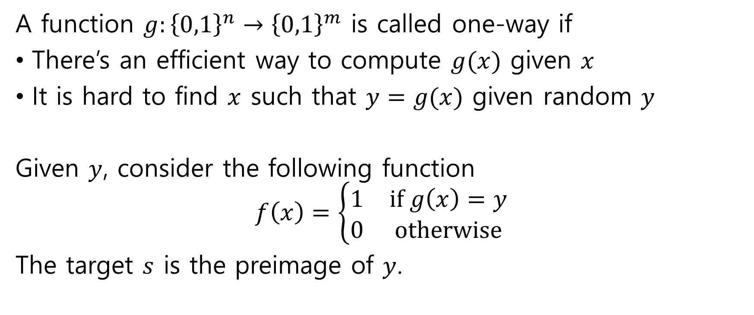
Abstract example: One-way function
A function $g:{\left\{0,1\right\}}^{n}→{\left\{0,1\right\}}^{m}$ is called one-way if
There’s an efficient way to compute $g(x)$ given $x$
It is hard to find $x$ such that $y=g(x)$ given random $y$
Given $y$, consider the following function
$$f\left(x\right)=\left\{\begin{matrix}1 & if g\left(x\right)=y \\ 0 & otherwise\end{matrix}\right.$$
The target $s$ is the preimage of $y$.

Slide 5
Concrete example: Password hashing
Storing password in plaintext is very dangerous. When a data breach happens, all the passwords are leaked. Thus, usually a hash function is used to “scramble” the passwords.
123456
111177
qwerty
quantum
.
.
.
7c4a8d09c…
15c3523fe…
b1b3773a…
56c3e9bf2…
.
.
.
SHA1

Slide 6
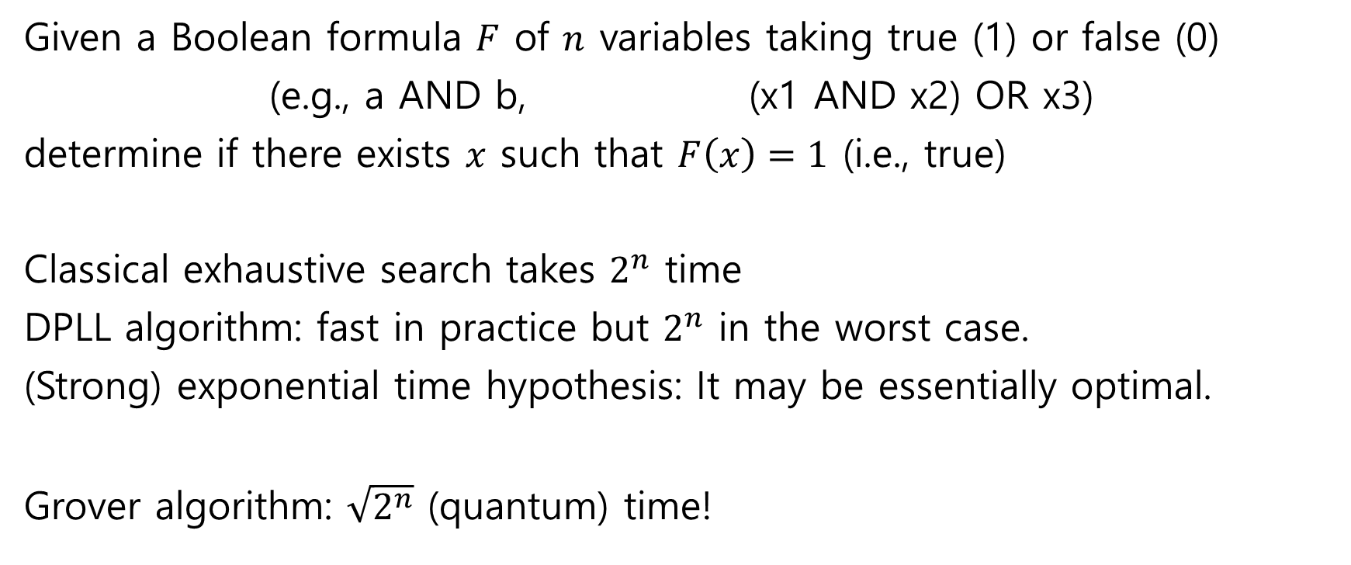
In theory: Satisfiability
Given a Boolean formula $F$ of $n$ variables taking true (1) or false (0)
(e.g., a AND b, (x1 AND x2) OR x3)
determine if there exists $x$ such that $F\left(x\right)=1$ (i.e., true)
Classical exhaustive search takes $2^{n}$ time
DPLL algorithm: fast in practice but $2^{n}$ in the worst case.
(Strong) exponential time hypothesis: It may be essentially optimal.
Grover algorithm: $\sqrt{2^{n}}$ (quantum) time!

Slide 7
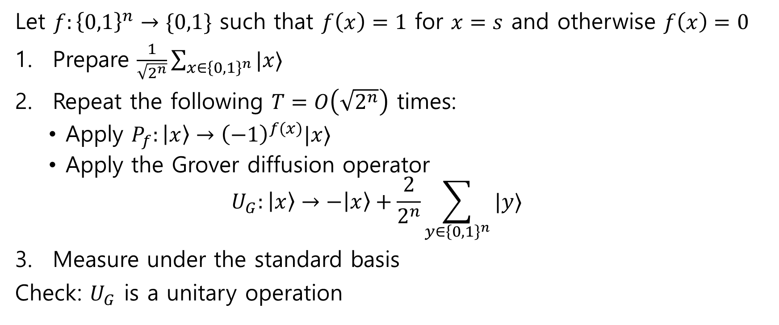
Grover algorithm
Let $f:{\left\{0,1\right\}}^{n}→\{0,1\}$ such that $f\left(x\right)=1$ for $x=s$ and otherwise $f\left(x\right)=0$
Prepare $\frac{1}{\sqrt{2^{n}}}\sum_{x∈{\left\{0,1\right\}}^{n}}{|x⟩}$
Repeat the following $T=O\left(\sqrt{2^{n}}\right)$ times:
Apply $P_{f}:\left|x\right\rangle →{\left(−1\right)}^{f(x)}|x⟩$
Apply the Grover diffusion operator
$$U_{G}:\left|x\right\rangle →−\left|x\right\rangle +\frac{2}{2^{n}}\sum_{y∈{\left\{0,1\right\}}^{n}}{|y⟩}$$
Measure under the standard basis
Check: $U_{G}$ is a unitary operation

Slide 8
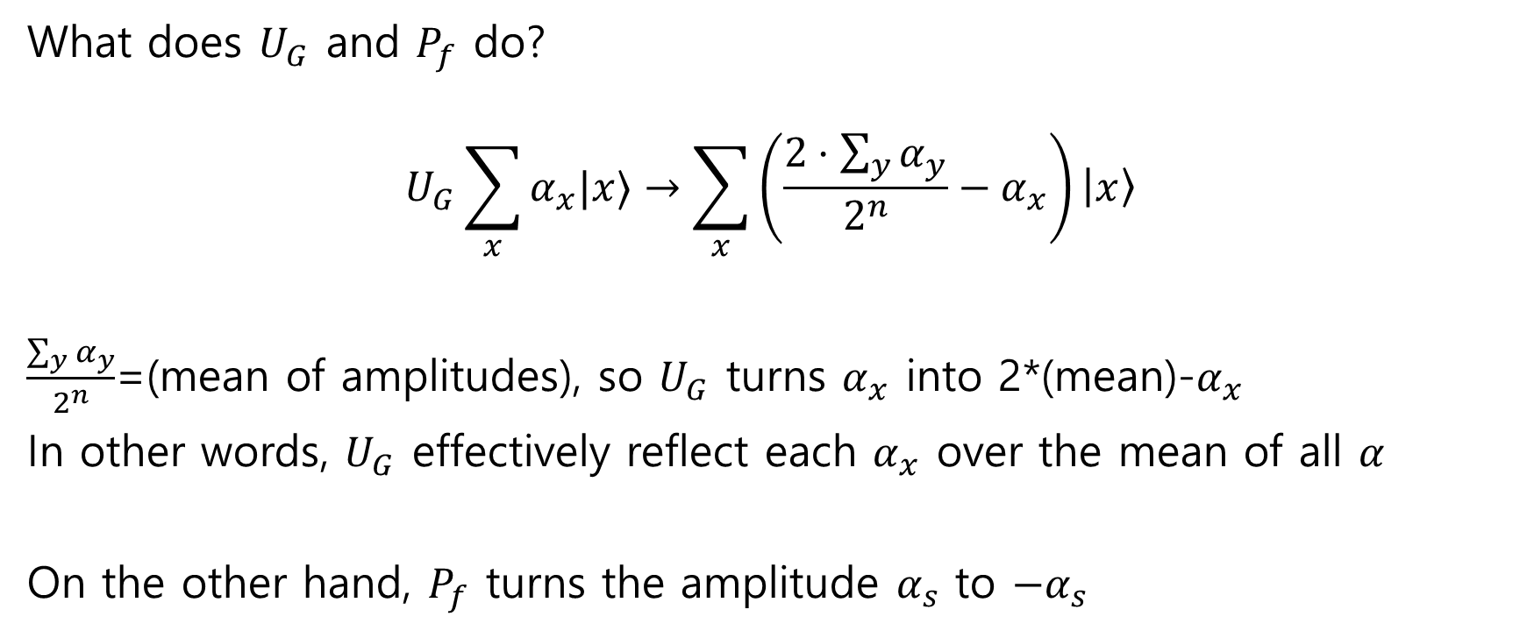
Grover algorithm, analysis
What does $U_{G}$ and $P_{f}$ do?
$$U_{G}\sum_{x}{α_{x}|x⟩}→\sum_{x}{\left(\frac{2⋅\sum_{y}{α_{y}}}{2^{n}}−α_{x}\right)}\left|x\right\rangle$$
$\frac{\sum_{y}{α_{y}}}{2^{n}}$=(mean of amplitudes), so $U_{G}$ turns $α_{x}$ into 2*(mean)-$α_{x}$
In other words, $U_{G}$ effectively reflect each $α_{x}$ over the mean of all $α$
On the other hand, $P_{f}$ turns the amplitude $α_{s}$ to $−α_{s}$

Slide 9










Grover algorithm, analysis
(full algorithm analysis sketch on board)
$$\left|0^{n}\right\rangle$$
$$H^{⊗n}$$
$$P_{f}$$
$$U_{G}$$
$$P_{f}$$
$$U_{G}$$
$$P_{f}$$
$$U_{G}$$
$O\left(\sqrt{N}\right)$ times

Slide 10
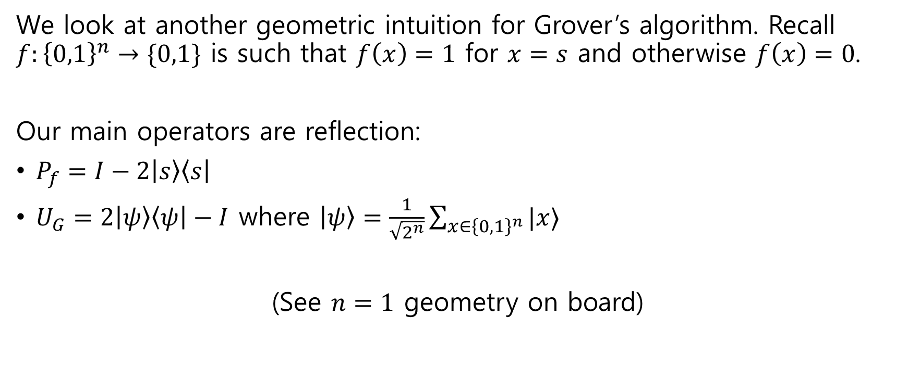
Grover algorithm, analysis
We look at another geometric intuition for Grover’s algorithm. Recall $f:{\left\{0,1\right\}}^{n}→\{0,1\}$ is such that $f\left(x\right)=1$ for $x=s$ and otherwise $f\left(x\right)=0$.
Our main operators are reflection:
$P_{f}=I−2\left|s\right\rangle \left\langle s\right|$
$U_{G}=2\left|ψ\right\rangle \left\langle ψ\right|−I$ where $\left|ψ\right\rangle =\frac{1}{\sqrt{2^{n}}}\sum_{x∈{\left\{0,1\right\}}^{n}}{|x⟩}$
(See $n=1$ geometry on board)

Slide 11
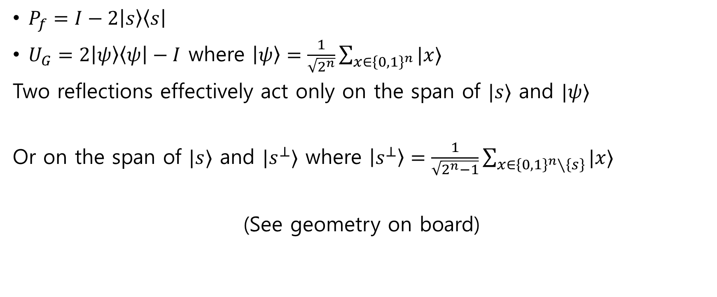
Grover algorithm, analysis
$P_{f}=I−2\left|s\right\rangle \left\langle s\right|$
$U_{G}=2\left|ψ\right\rangle \left\langle ψ\right|−I$ where $\left|ψ\right\rangle =\frac{1}{\sqrt{2^{n}}}\sum_{x∈{\left\{0,1\right\}}^{n}}{|x⟩}$
Two reflections effectively act only on the span of $|s⟩$ and $|ψ⟩$
Or on the span of $|s⟩$ and $|s^{⊥}⟩$ where $\left|s^{⊥}\right\rangle =\frac{1}{\sqrt{2^{n}−1}}\sum_{x∈{\left\{0,1\right\}}^{n}∖\left\{s\right\}}{|x⟩}$
(See geometry on board)

Slide 12



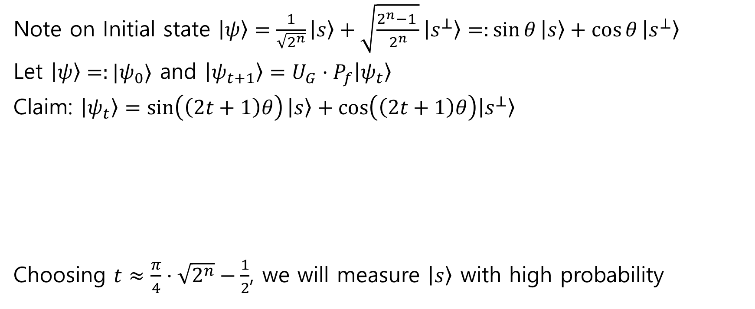






Grover algorithm, analysis
$$\sin{θ}=\frac{1}{\sqrt{2^{n}}}$$
Note on Initial state $\left|ψ\right\rangle =\frac{1}{\sqrt{2^{n}}}\left|s\right\rangle +\sqrt{\frac{2^{n}−1 }{2^{n}}}\left|s^{⊥}\right\rangle =:\sin{θ}\left|s\right\rangle +\cos{θ}\left|s^{⊥}\right\rangle$
Let $\left|ψ\right\rangle =:|ψ_{0}⟩$ and $\left|ψ_{t+1}\right\rangle =U_{G}⋅P_{f}\left|ψ_{t}\right\rangle$
Claim: $\left|ψ_{t}\right\rangle =\sin\left(\left(2t+1\right)θ\right)\left|s\right\rangle +\cos\left(\left(2t+1\right)θ\right)\left|s^{⊥}\right\rangle$
Choosing $t≈\frac{π}{4}⋅\sqrt{2^{n}}−\frac{1}{2}$, we will measure $\left|s\right\rangle$ with high probability
$$\left|s\right\rangle$$
$$\left|ψ_{1}\right\rangle =U_{G}P_{f}\left|ψ_{0}\right\rangle$$
$$2θ$$
$$\left|ψ_{0}\right\rangle =|ψ⟩$$
$$θ$$
$$|s^{⊥}⟩$$
$$θ$$
$$P_{f}\left|ψ_{0}\right\rangle$$

Slide 13
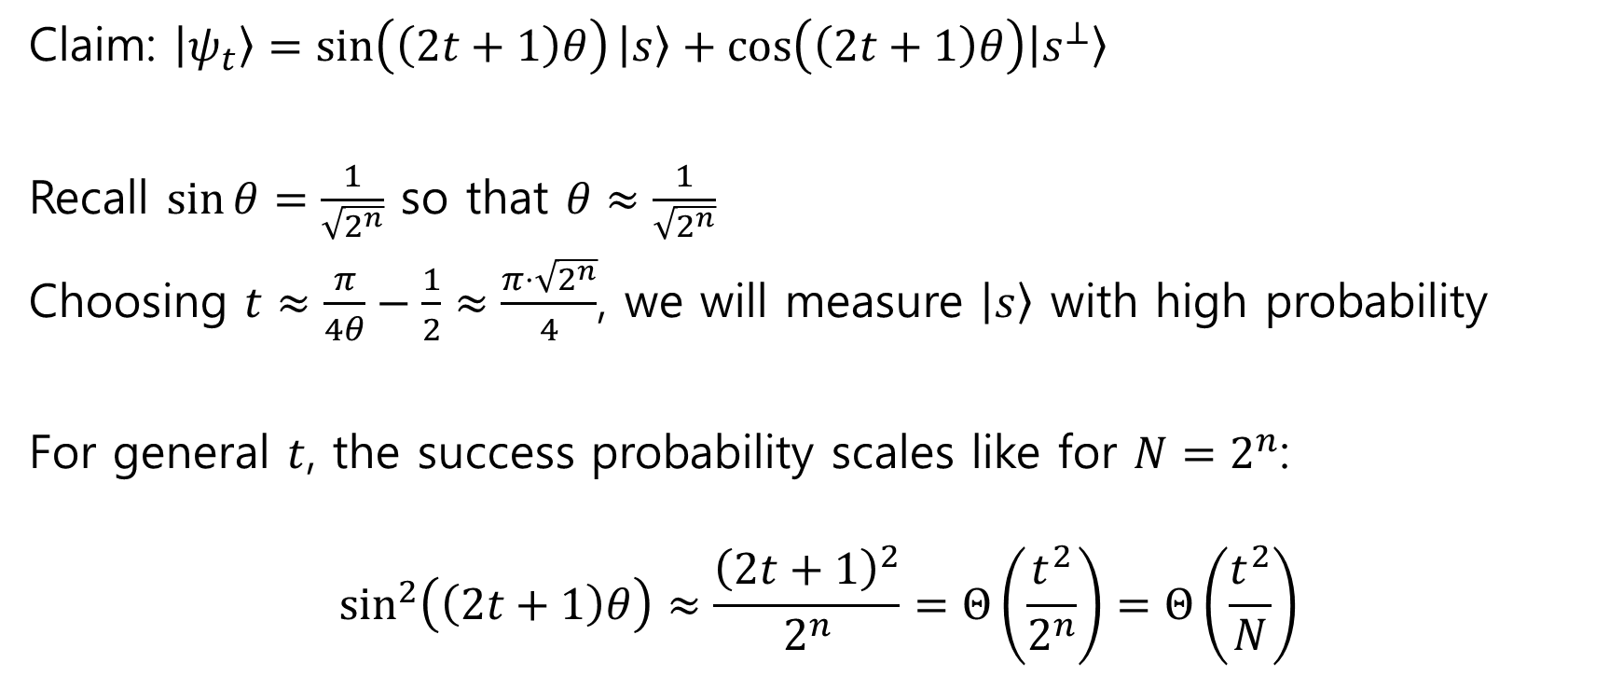
Grover algorithm, analysis
Claim: $\left|ψ_{t}\right\rangle =\sin\left(\left(2t+1\right)θ\right)\left|s\right\rangle +\cos\left(\left(2t+1\right)θ\right)\left|s^{⊥}\right\rangle$
Recall $\sin{θ}=\frac{1}{\sqrt{2^{n}}}$ so that $θ≈\frac{1}{\sqrt{2^{n}}}$
Choosing $t≈\frac{π}{4θ}−\frac{1}{2}≈\frac{π⋅\sqrt{2^{n}}}{4}$, we will measure $\left|s\right\rangle$ with high probability
For general $t$, the success probability scales like for $N=2^{n}$:
$$\sin^{2}\left(\left(2t+1\right)θ\right)≈\frac{{\left(2t+1\right)}^{2}}{2^{n}}=Θ\left(\frac{t^{2}}{2^{n}}\right)=Θ\left(\frac{t^{2}}{N}\right)$$

Slide 14
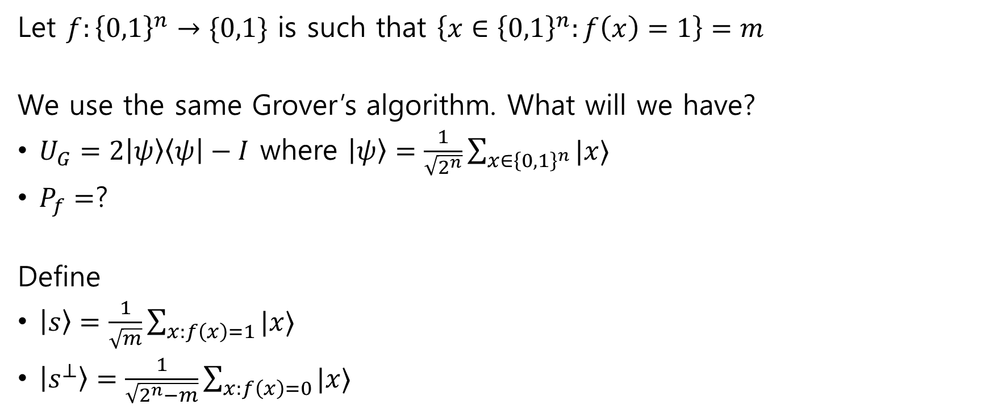
Generalization to multiple solutions
Let $f:{\left\{0,1\right\}}^{n}→\{0,1\}$ is such that $\left\{x∈{\left\{0,1\right\}}^{n}:f\left(x\right)=1\right\}=m$
We use the same Grover’s algorithm. What will we have?
$U_{G}=2\left|ψ\right\rangle \left\langle ψ\right|−I$ where $\left|ψ\right\rangle =\frac{1}{\sqrt{2^{n}}}\sum_{x∈{\left\{0,1\right\}}^{n}}{|x⟩}$
$P_{f}=$?
Define
$\left|s\right\rangle =\frac{1}{\sqrt{m}}\sum_{x:f\left(x\right)=1}{|x⟩}$
$\left|s^{⊥}\right\rangle =\frac{1}{\sqrt{2^{n}−m}}\sum_{x:f\left(x\right)=0}{|x⟩}$

Slide 15
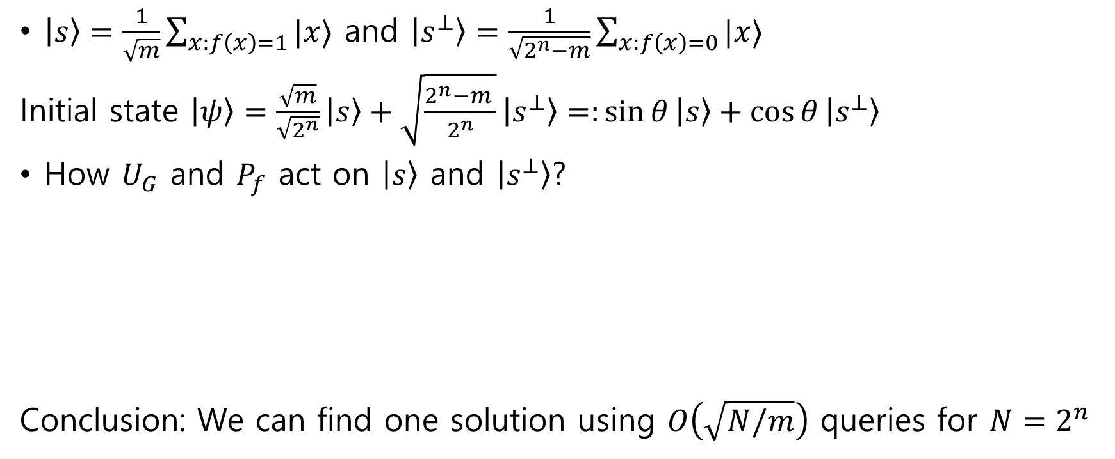
Generalization to multiple solutions
$\left|s\right\rangle =\frac{1}{\sqrt{m}}\sum_{x:f\left(x\right)=1}{|x⟩}$ and $\left|s^{⊥}\right\rangle =\frac{1}{\sqrt{2^{n}−m}}\sum_{x:f\left(x\right)=0}{|x⟩}$
Initial state $\left|ψ\right\rangle =\frac{\sqrt{m}}{\sqrt{2^{n}}}\left|s\right\rangle +\sqrt{\frac{2^{n}−m }{2^{n}}}\left|s^{⊥}\right\rangle =:\sin{θ}\left|s\right\rangle +\cos{θ}\left|s^{⊥}\right\rangle$
How $U_{G}$ and $P_{f}$ act on $\left|s\right\rangle$ and $\left|s^{⊥}\right\rangle$?
Conclusion: We can find one solution using $O\left(\sqrt{N/m}\right)$ queries for $N=2^{n}$

Slide 16

Generalization to multiple solutions
Let $f:{\left\{0,1\right\}}^{n}→\{0,1\}$ is such that $\left\{x∈{\left\{0,1\right\}}^{n}:f\left(x\right)=1\right\}=m$
What if we want to find all $m$ solutions?
Conclusion: We can find all $m$ solutions using $O\left(\sqrt{Nm}\right)$ queries for $N=2^{n}$

Slide 17
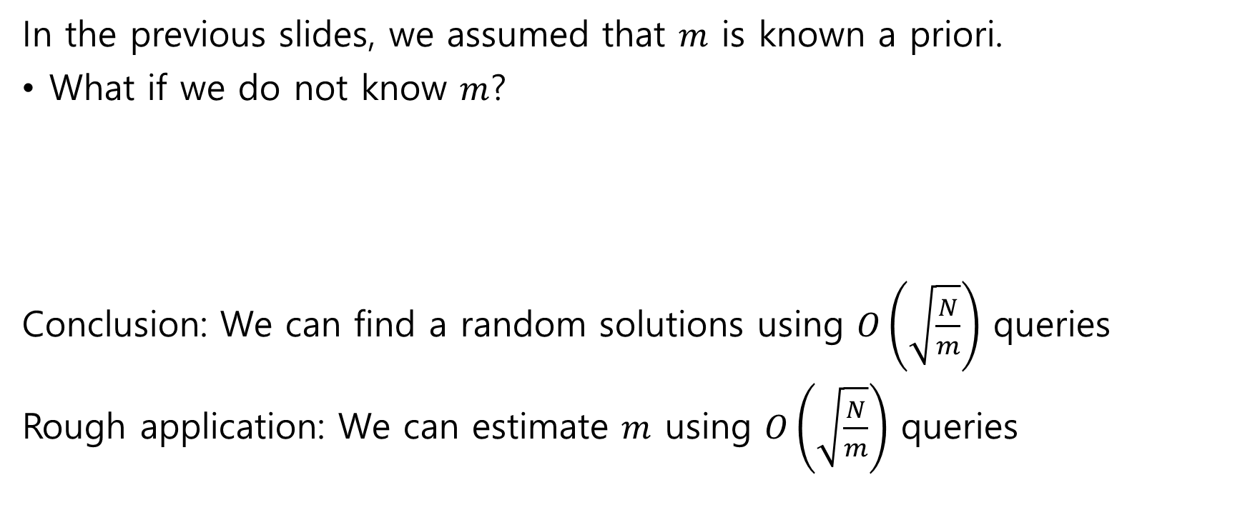
Generalization to multiple solutions
In the previous slides, we assumed that $m$ is known a priori.
What if we do not know $m$?
Conclusion: We can find a random solutions using $O\left(\sqrt{\frac{N}{m}}\right)$ queries
Rough application: We can estimate $m$ using $O\left(\sqrt{\frac{N}{m}}\right)$ queries

Slide 18
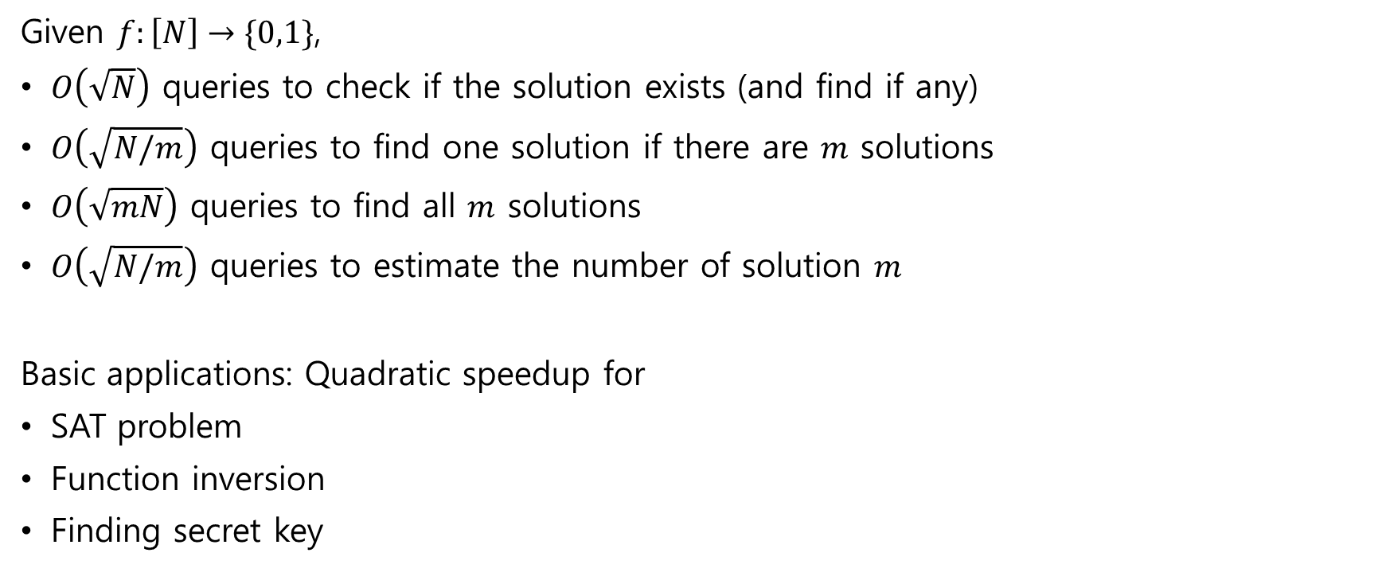
Grover algorithm summary
Given $f:\left[N\right]→\{0,1\}$,
$O\left(\sqrt{N}\right)$ queries to check if the solution exists (and find if any)
$O\left(\sqrt{N/m}\right)$ queries to find one solution if there are $m$ solutions
$O\left(\sqrt{mN}\right)$ queries to find all $m$ solutions
$O\left(\sqrt{N/m}\right)$ queries to estimate the number of solution $m$
Basic applications: Quadratic speedup for
SAT problem
Function inversion
Finding secret key

Slide 19

Further applications: Minimum finding
Suppose that Let $f:{\left\{0,1\right\}}^{n}→X$ is an injective function, where $X$ is an ordered set (e.g., $X=ℝ$).
Problem: Find $x$ such that $f(x)$ is the minimum using $\sqrt{2^{n}}$ queries

Slide 20

Further applications: Collision finding
Suppose that Let $f:{\left\{0,1\right\}}^{n+1}→{\left\{0,1\right\}}^{n}$ is a two-to-one function.
Problem: Find a collision $\left(x,y\right)$ such that $f\left(x\right)=f\left(y\right)$ using $2^{n/3}$ queries

Slide 21
Nontrivial applications of Grover
We will try to cover various applications of Grover’s algorithm and analysis.
Potential topics:
Graph connectivity
Traveling salesman problem
“Quantum” probability amplification
Element distinctness
Quantum collision finding revisited
This lecture will be only on board.
The covered topic will be uploaded as a note.
Some uncovered topics may appear in homework.

